Slide 1

Introduction to MLOps

Slide 2
1
Why MLOps
2
What is Machine Learning (Recap)
Agenda
3
What is HTTP
4
What is Docker
5
What is Kubernetes
6
Hands On

Slide 3

1
Why MLOps

Slide 4
2
What is Machine Learning

Slide 5
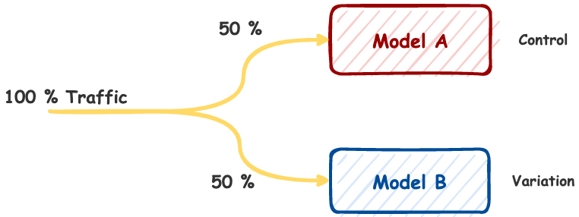
A/B Testing
Compares two variants of one variable:
Determines which variant performs better
Used in advertisement a lot
Objectively measure the results
Pick a metric

Slide 6
3
What is HTTP

Slide 7
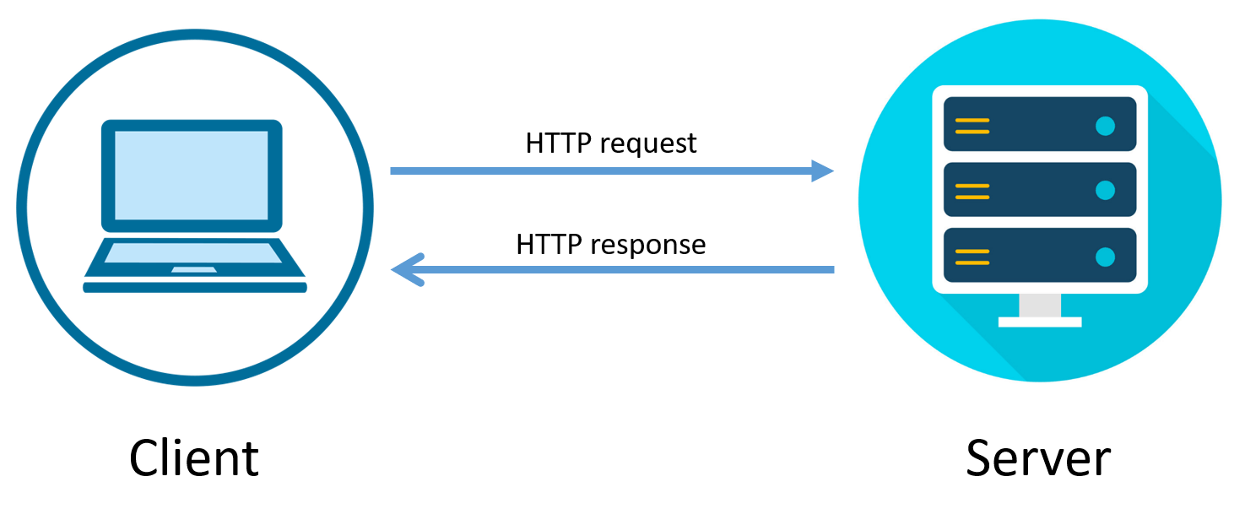
HTTP
Communication between client and server
In Python Flask, Django, FastAPI, etc.

Slide 8
4
What is Docker

Slide 9

Docker
PIP for Kubernetes
Package manager
Has charts

Slide 10
5
What is Kubernetes

Slide 11

Kubernetes
Container Orchestrator
Controller
Pods
Containers
Services

Slide 12
6
What will we be doing

Slide 13
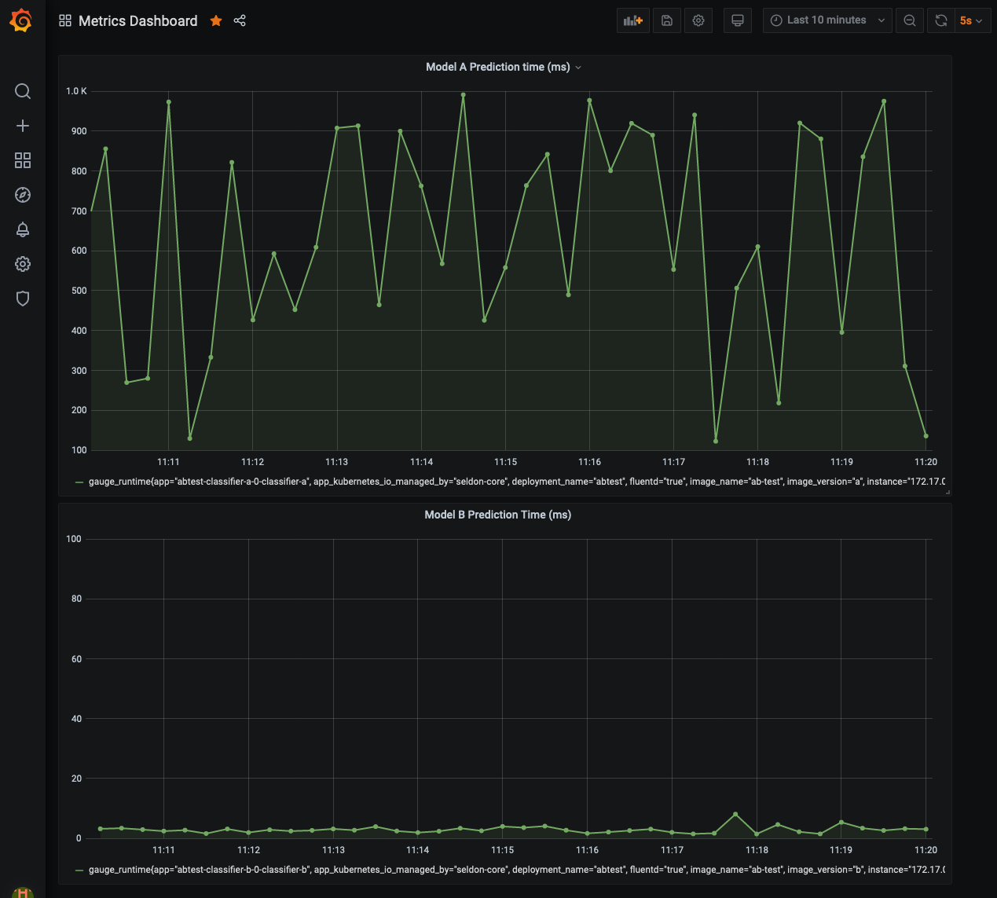

Slide 14

Resources
https://github.com/data-max-hq/ab-testing-in-ml
https://towardsdatascience.com/a-practical-guide-to-a-b-testing-in-mlops-with-kubernetes-and-seldon-core-e75e91ef91ef
https://github.com/SeldonIO/seldon-core/tree/master/examples/models/sklearn_spacy_text

Slide 15
1
What is A/B testing
Hands On
2
What is Kubenetes
3
What is Helm
4
What is seldon
5
Hands On

Slide 16
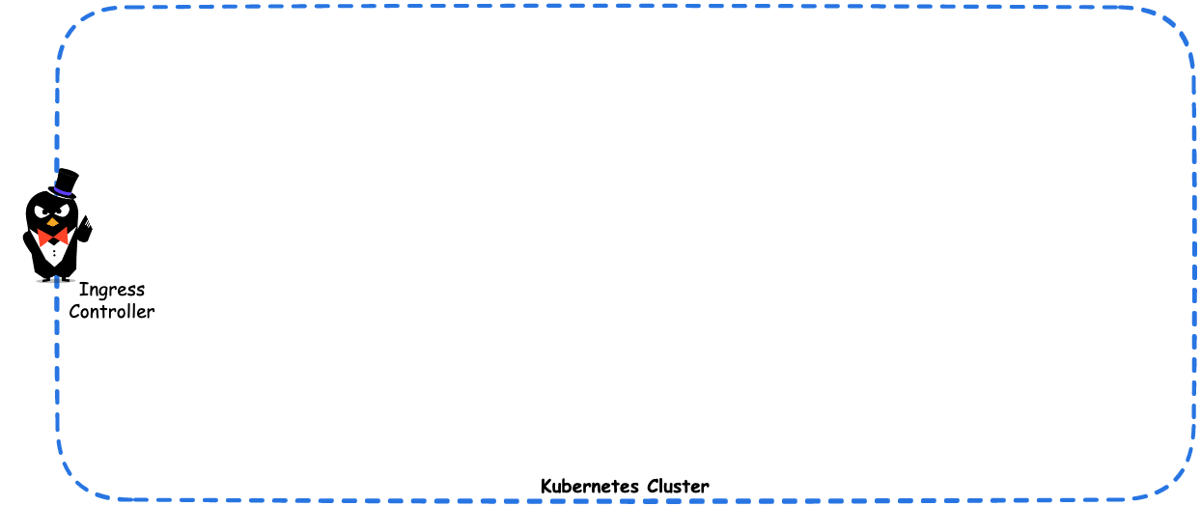
Where are we now

Slide 17
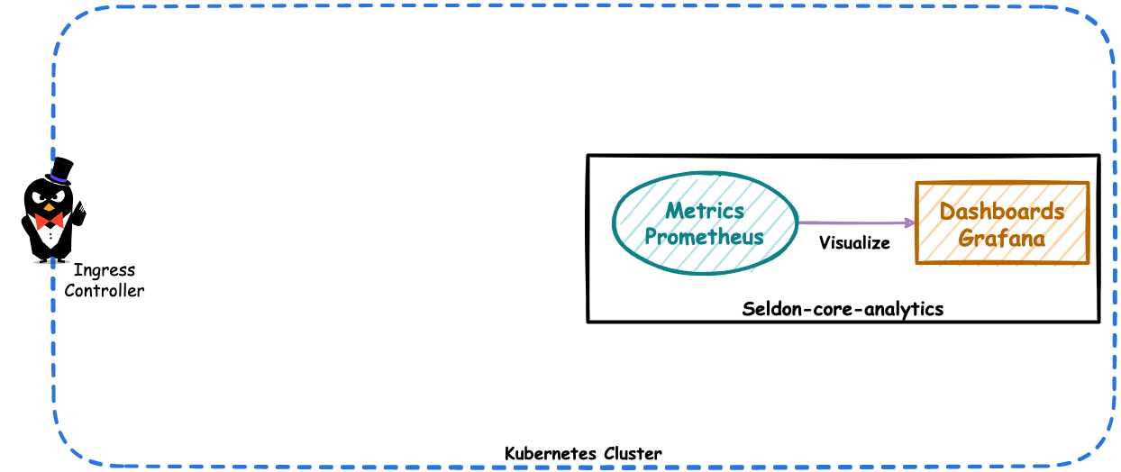
Where are we now

Slide 18
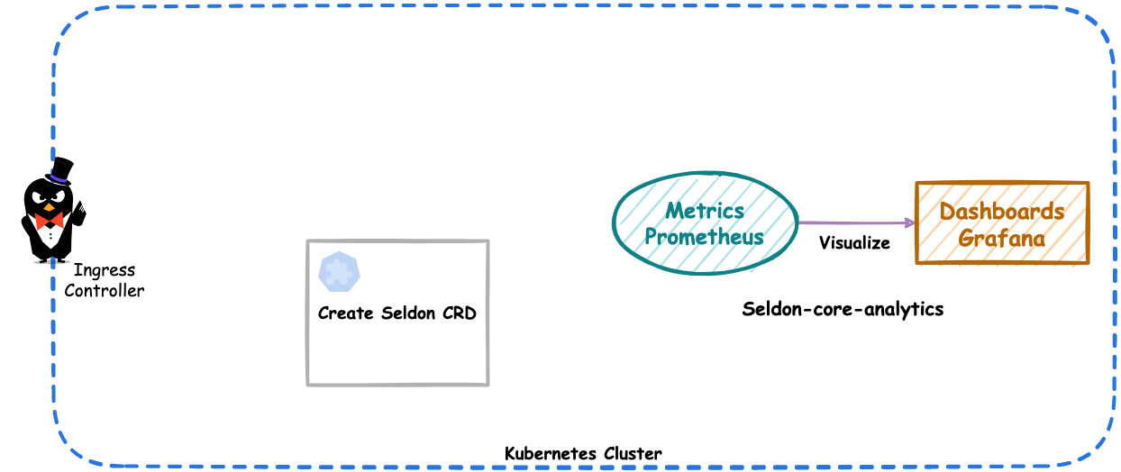
Where are we now

Slide 19
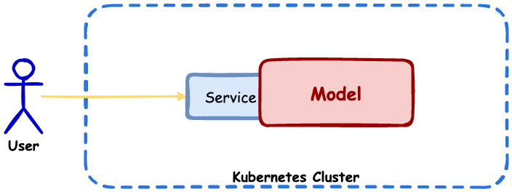
Where are we now

